Slide 1
Postmodernism & truth
By: Chancellor Cochran

Slide 2
Modernism
A search for new forms of expression that focused on self-consciousness
Rejected enlightenment period ideals and religious beliefs
Resulted from horrors of WWI
Notes:
We need to understand modernism in order to understand postmodernism
Reclining figure- henry moore

Slide 3
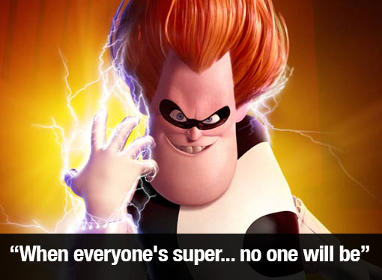
postmodernism
Reaction to Modernism
No absolute truth
Truth is relative
Embodies complexity, contradiction, ambiguity, diversity and interconnectedness
If everyone is true, then no one is true
Openness to meaning
No right or wrong
Plays with convention
Notes:
Defining postmodernism is hypocritical because the very essence of postmodernism is that there are no absolute truths or definitions.

Slide 4
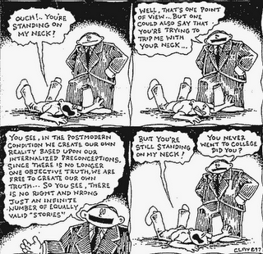
Notes:
Most accurate portrayal I could find

Slide 5
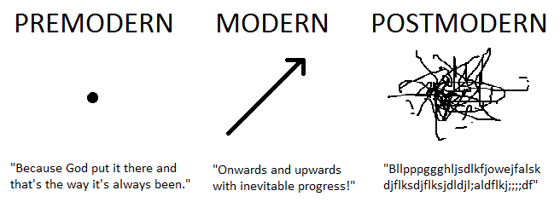

Slide 6
Breaking bad
Chemistry teacher, Walter White, struggles with his legacy as he deals with his terminal cancer
Question your legacy
Notes:
Is making meth wrong?

Slide 7
Sons of anarchy
Story of bike gangster, Jax Teller, and his path to save his club and family from the past, while discovering a new sense of identity
Question your identity
Notes:
Is killing for your family wrong?

Slide 8
Dexter
Story of Serial killer/ Miami blood analyst, Dexter Morgan, and his journey to cleanse the world of people who fit hit moral code
Question your morals
Notes:
Is murder wrong?

Slide 9
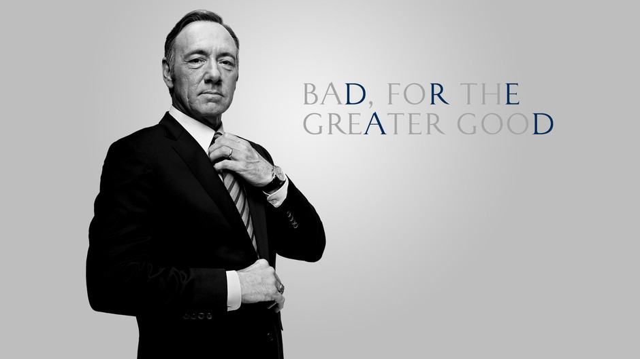
House of cards
Frank Underwood, politician does bad for the greater good of his country
Question your integrity and truths
Notes:
Is lying and deceit wrong for the greater good?

Slide 10
Postmodernism in media
All of these shows blur the line between right and wrong
We root for the anti-hero
Play on our former ideas of the way things should be
Make us question everything and rethink what is right and wrong
Obscure what we as society know as true
More “truths” becomes relative

Slide 11
Advantages of postmodernism
New thinking and new ideas
Sensitivity to other’s ideas
Awareness of differences
Offers unique perspectives
Wide philosophical view
Understanding of human finitude
Take charge of your meaning

Slide 12
Disadvantages of postmodernism
Lost sense of meaning, identity, morals and truth
No room for God in this view, because of the paradox
No truths
Lack of purpose
No need to live righteously
Too tolerant and non-judgmental

Slide 13
Consequences of postmodernism
Evangelism is dead because of lack of morals
Morality is dead because of lack of truth
Acceptance of immoral behaviors in society
Society becomes more upset about what people say than what people do
Political correctness does the opposite of what it is intended to do
Our children and future generations may lose moral compass because of exposure to postmodernism
Theory: violence and pain the only way in which we feel alive in a postmodern view
Notes:
There is a reason post modern shows revolve around death

